Slide 1
Overview of Behavioral Patterns

Slide 2
Behavioral Patterns
Are concerned with algorithms and the assignment of responsibilities between objects.
Describe the way objects interact with each other and the patterns of communication between them.
Use inheritance to distribute behavior between classes.
Help make complex behavior manageable by specifying the responsibilities of objects and the ways they communicate with each other.

Slide 3
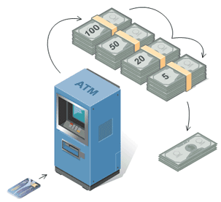
Behavioral Design Patterns
Chain of Responsibility – A way of passing a request between a chain of objects.
ATM use the Chain of Responsibility in money giving mechanism.

Slide 4
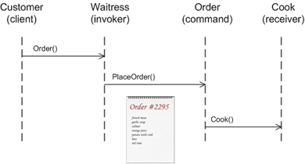
Behavioral Design Patterns
Command (a.k.a. Action or Transaction) – Encapsulate a command request as an object.
The “check” at a diner is an example of a Command pattern. The waiter or waitress takes an order or command from a customer and encapsulates that order by writing it on the check. The order is then queued for a short order cook. Note that the pad of “checks” used by each waiter is not dependent on the menu, and therefore they can support commands to cook many different items.

Slide 5
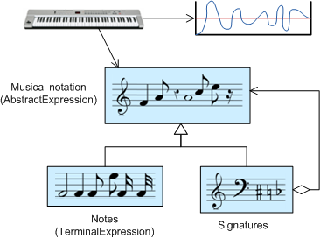
Behavioral Design Patterns
Interpreter – A way to include language elements in a program.
Musicians are examples of Interpreters. The pitch of a sound and its duration can be represented in musical notation on a staff. This notation provides the language of music. Musicians playing the music from the score are able to reproduce the original pitch and duration of each sound represented.

Slide 6
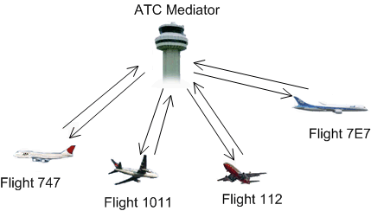
Behavioral Design Patterns (continued)
Mediator – Defines simplified communication between classes.
The control tower at a controlled airport demonstrates this pattern very well. The pilots of the planes approaching or departing the terminal area communicate with the tower rather than explicitly communicating with one another. The constraints on who can take off or land are enforced by the tower. It is important to note that the tower does not control the whole flight. It exists only to enforce constraints in the terminal area.

Slide 7
Behavioral Design Patterns (continued)
Iterator (a.k.a. Cursor) – Sequentially access the elements of a collection.
In office settings where access to files is made through administrative or secretarial staff, the Iterator pattern is demonstrated with the secretary acting as the Iterator. Several television comedy skits have been developed around the premise of an executive trying to understand the secretary’s filing system. To the executive, the filing system is confusing and illogical, but the secretary is able to access files quickly and efficiently.

Slide 8
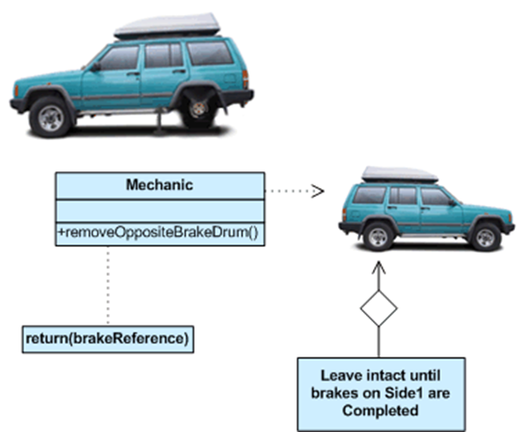
Behavioral Design Patterns (continued)
Memento – Capture and restore an object’s internal state.
This pattern is common among do-it-yourself mechanics repairing drum brakes on their cars. The drums are removed from both sides, exposing both the right and left brakes. Only one side is disassembled and the other serves as a Memento of how the brake parts fit together. Only after the job has been completed on one side is the other side disassembled. When the second side is disassembled, the first side acts as the Memento.

Slide 9
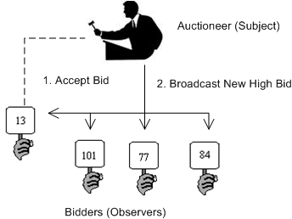
Behavioral Design Patterns (continued)
Observer (a.k.a. Model/View or Publish/Subscribe) – A way of notifying change to a number of classes.
Some auctions demonstrate this pattern. Each bidder possesses a numbered paddle that is used to indicate a bid. The auctioneer starts the bidding, and “observes” when a paddle is raised to accept the bid. The acceptance of the bid changes the bid price which is broadcast to all of the bidders in the form of a new bid.

Slide 10
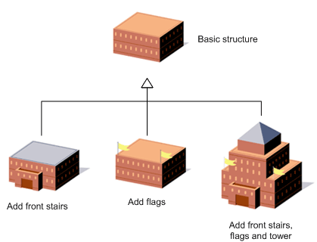
Behavioral Design Patterns (continued)
Template Method – Defer the exact steps of an algorithm to a subclass.
Home builders use the Template Method when developing a new subdivision. A typical subdivision consists of a limited number of floor plans with different variations available for each. Within a floor plan, the foundation, framing, plumbing, and wiring will be identical for each house. Variation is introduced in the later stages of construction to produce a wider variety of models.

Slide 11
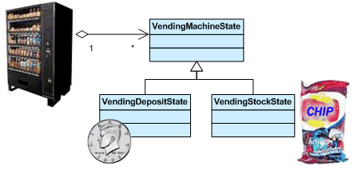
Behavioral Design Patterns (continued)
State – Alter an object’s behavior when its state changes.
This pattern can be observed in a vending machine. Vending machines have states based on the inventory, amount of currency deposited, the ability to make change, the item selected, etc. When currency is deposited and a selection is made, a vending machine will either deliver a product and no change, deliver a product and change, deliver no product due to insufficient currency on deposit, or deliver no product due to inventory depletion.

Slide 12
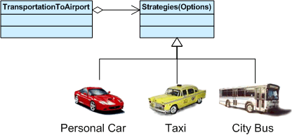
Behavioral Design Patterns (continued)
Strategy (a.k.a. Policy) – Encapsulates an algorithm inside a class.
Modes of transportation to an airport is an example of a Strategy. Several options exist such as driving one’s own car, taking a taxi, an airport shuttle, a city bus, or a limousine service. For some airports, subways and helicopters are also available as a mode of transportation to the airport. Any of these modes of transportation will get a traveler to the airport, and they can be used interchangeably. The traveler must chose the Strategy based on tradeoffs between cost, convenience, and time.

Slide 13
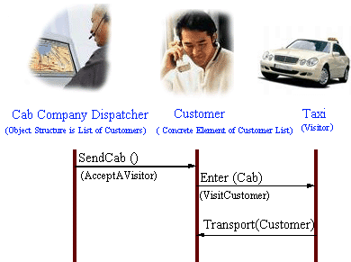
Behavioral Design Patterns (continued)
Visitor – Defines a new operation to a class without change.
This pattern can be observed in the operation of a taxi company. When a person calls a taxi company (accepting a visitor), the company dispatches a cab to the customer. Upon entering the taxi the customer, or Visitor, is no longer in control of his or her own transportation, the taxi (driver) is.

Slide 14
References
Behavioral pattern (Wikipedia)
http://en.wikipedia.org/wiki/Behavioral_pattern
Behavioral patterns (Source Making)
http://sourcemaking.com/behavioral_patterns
Behavioral Patterns: Rules of Thumb (Vince Huston)
http://www.vincehuston.org/dp/behavioral_rules.html

